Slide 1
TURO Case Study
Sucharu Gupta
Masters in Statistics, San Jose State University
sucharu7115@gmail.com
669-236-9765

Slide 2
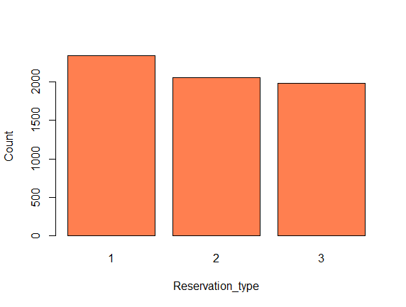
Data Analysis
Created Four Frequency tables from Reservation and vehicle data.
Scenario 1 has the total number of Reservations(All three type) for each vehicle ID
Scenario 2 has Total number of Hourly Reservations for each vehicle ID
Scenario 3 has Total number of Daily Reservations for each vehicle ID
Scenario 4 has Total number of Weekly Reservations for each vehicle ID
Reason for above 4 scenarios is that there can be different factors which can affect different type of Reservations differently.
2339
2057
1980
We can see there are significant number of reservations for all three types. So we have sufficient data to analyze them Individually.

Slide 3
Statistical Distribution Selection
This is frequency based data so have to use either Poison distribution or Negative binomial distribution.
I chose Negative Binomial for analysis not Poison distribution
Poison Distribution is good only when Mean is equal to Variance of response variable. In following table we can see in all the Scenarios Mean is not equal to Variance. So this is an over dispersed data, for such data Negative Binomial is best for analysis.
Cases | Mean | Variance
Scenario 1 | 6.37 | 23.63
Scenario 2 | 2.34 | 4.77
Scenario 3 | 2.06 | 3.82
Scenario 4 | 1.98 | 3.58

Slide 4
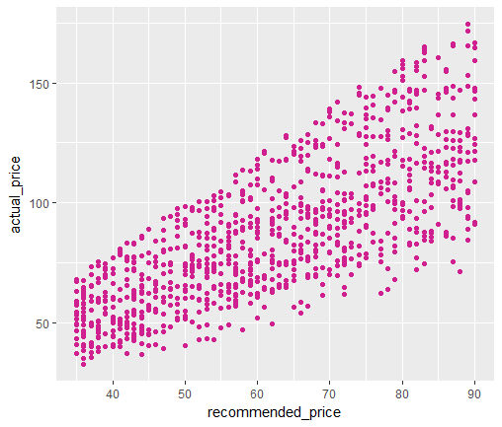
Plot between actual price and recommended price
We can see from the Graph that there is positive correlation between actual price and recommended price and the correlation amount is 75.9%
Coefficients: | Estimate | Std. Error | z value | Pr(>|z|)
(Intercept) | 1.34E+00 | 1.286e-01 | 10.451 | < 2e-16 ***
technology1 | 9.40E-02 | 6.911e-02 | 1.360 | 0.174
actual_price - | 1.51E-02 | 1.283e-03 | -11.762 | < 2e-16 ***
recommended_price | 2.17E-02 | 2.236e-03 | 9.718 | < 2e-16 ***
num_images | 1.40E-01 | 1.748e-02 | 8.002 | 1.22e-15 ***
street_parked1 - | 3.46E-02 | 4.683e-02 | -0.738 | 0.460
description | 3.44E-05 | 3.041e-04 | 0.113 | 0.910
Also in the model data we can see for these two variables the pvalue is same.
From above observations we can say that including both variables in our model is not going to provide any new information so we can choose any.

Slide 5
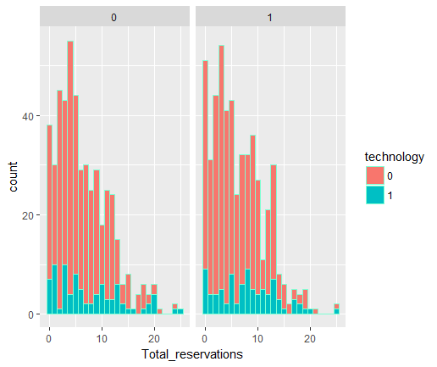
Exploratory Analysis
Graph between Technology, Street parking, Total reservation
Street_parked
We can see there is not much difference in two graphs. This means street parking is not impacting the reservations.
Graph shows during reservations customers are not considering Technology much.

Slide 6
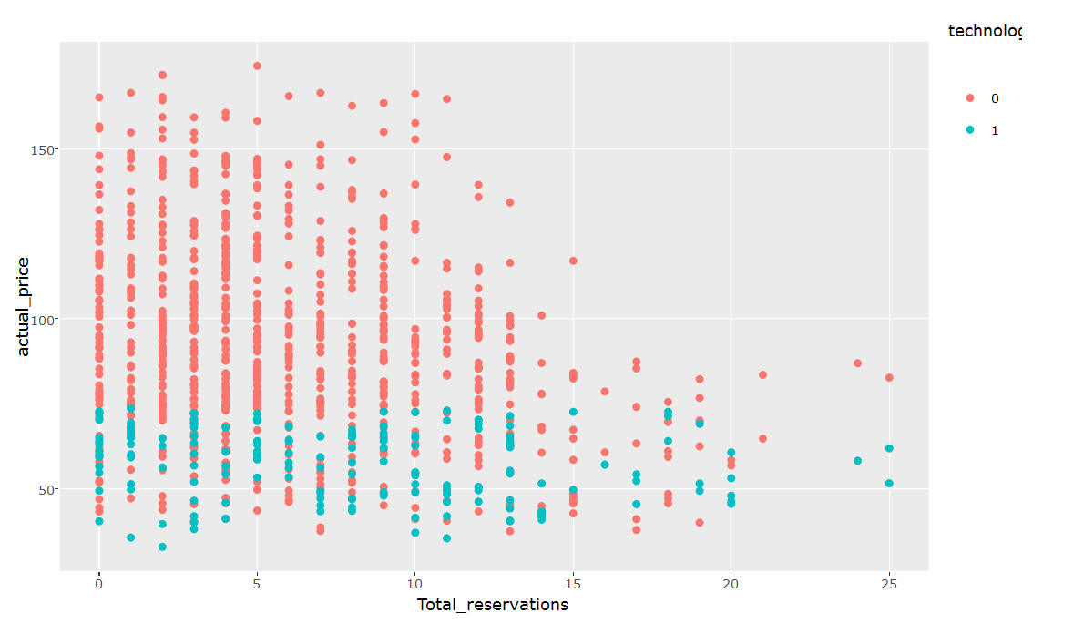
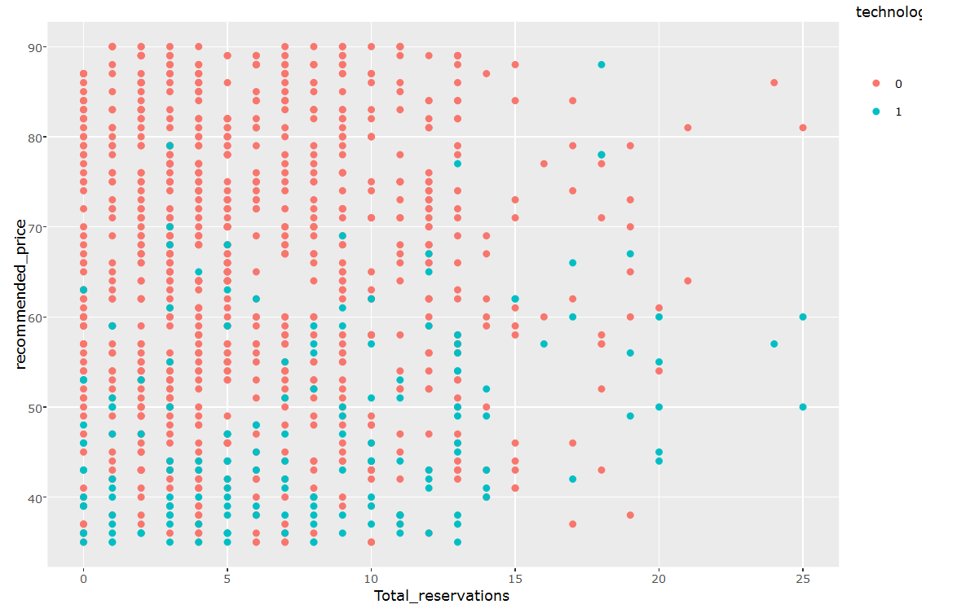
Exploratory Analysis
Graph between Technology, Actual price , Total reservation
Graph between Technology, Recommended price , Total reservation
For Lower price vehicles the recommended price is almost same as actual price.
For higher price vehicles, recommended price never exceed 90. Which is on far lower side than actual price.
For lower priced vehicles, technology is significant factor for reservations.

Slide 7
Models
Scenario 1 (All type of Reservations)
Scenario 2 ( Only Hourly reservations)
Scenario 3 ( Only Daily reservations)
Coefficients: | Estimate | Std. Error | z value | Pr(>|z|)
(Intercept) | 2.025067 | 0.1172604 | 17.27 | < 2e-16 | ***
technology1 | 0.0354107 | 0.0720732 | 0.491 | 0.623
actual_price | -0.0066913 | 0.0009522 | -7.027 | 2.11E-12 | ***
num_images | 0.1261403 | 0.0182838 | 6.899 | 5.24E-12 | ***
street_parked1 | -0.0326733 | 0.0490977 | -0.665 | 0.506
description | 0.0001331 | 0.000319 | 0.417 | 0.676
Coefficients: | Estimate | Std. Error | z value | Pr(>|z|)
(Intercept) | 0.9066946 | 0.1372539 | 6.606 | 3.95E-11 | ***
technology1 | 0.039947 | 0.0815982 | 0.49 | 0.624
actual_price | -0.0070221 | 0.0011278 | -6.226 | 4.78E-10 | ***
num_images | 0.156765 | 0.0213149 | 7.355 | 1.91E-13 | ***
street_parked1 | -0.0395585 | 0.0569824 | -0.694 | 0.488
description | 0.0006034 | 0.0003677 | 1.641 | 0.101
Coefficients: | Estimate | Std. Error | z value | Pr(>|z|)
(Intercept) | 0.9113417 | 0.141468 | 6.442 | 1.18E-10 | ***
technology1 | 0.0915619 | 0.0839914 | 1.09 | 0.276
actual_price | -0.0063253 | 0.0011637 | -5.435 | 5.47E-08 | ***
num_images | 0.1177203 | 0.0219853 | 5.354 | 8.58E-08 | ***
street_parked1 | -0.0490989 | 0.0588871 | -0.834 | 0.404
description | -0.0001402 | 0.0003836 | -0.366 | 0.715
Scenario 4 ( Only Weekly reservations)
In all the scenarios Pricing and Number of images are the most significant factors.
Coefficients: | Estimate | Std. Error | z value | Pr(>|z|)
(Intercept) | 0.9813931 | 0.144358 | 6.798 | 1.06E-11 | ***
technology1 | -0.027987 | 0.087504 | -0.32 | 0.749092
actual_price | -0.0063077 | 0.0011864 | -5.317 | 1.06E-07 | ***
num_images | 0.0842724 | 0.0225082 | 3.744 | 0.000181 | ***
street_parked1 | 0.0042413 | 0.0604183 | 0.07 | 0.944035
description | -0.0001955 | 0.0003938 | -0.496 | 0.619548

Slide 8
CONCLUSION
Which of the factors seem to be most important in driving total # of reservations for our vehicles? (technology type, pricing, number of car photos, street parking, car description length)
From the Models we can see Pricing and Number of images are the most Important factors overall for any type of reservation
How does the car's technology type seem to affect reservations?
For lower priced vehicles, technology is impacting reservations. (Explained in slide 6)
From previous analysis, for higher actual_price vehicles recommended_price always remains in lower range(<90). Following model with recommended price as variable shows technology becomes significant factor. So this analysis further enforces that for lower price vehicles technology is important.
Coefficients: | Estimate | Std. Error | z value | Pr(>|z|)
(Intercept) | 1.2037419 | 0.1365397 | 8.816 | < 2e-16 | ***
technology1 | 0.3150690 | 0.0722349 | 4.362 | 1.29E-05 | ***
recommended_price | 0.0029755 | 0.0017220 | 1.728 | 0.084 | *
num_images | 0.1300967 | 0.0186849 | 6.963 | 3.34E-12 | ***
street_parked1 | -0.0317503 | 0.0502173 | -0.632 | 0.527
description | 0.0001581 | 0.0003263 | 0.485 | 0.628

